Slide 1
Analytics for Customization
Customer Analytics

Slide 2
Customer lifecycle
Customer development: change in behavior over time: buying more (up-selling) or different things (cross-selling)
Customer acquisition:
how customers are “born” or first contact with the firm.
Customer retention: preventing customer “death” or churn.
Marketing is about acquiring, developing and retaining customers
Notes:
Customers go through stages in their relationship with the firm.

Slide 3
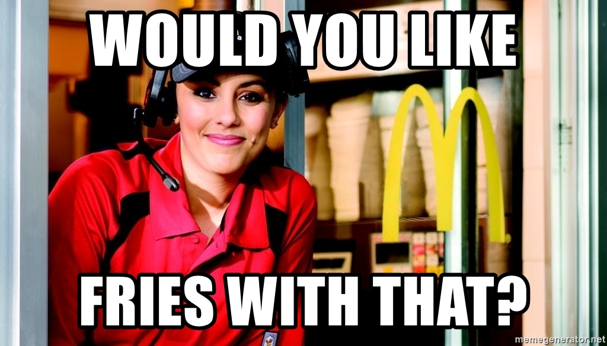
Cross-selling
Getting customers to buy other products of the firm that customer has not already bought
Notes:
A bank has a million customers but most use only 1 or 2 of its services

Slide 4
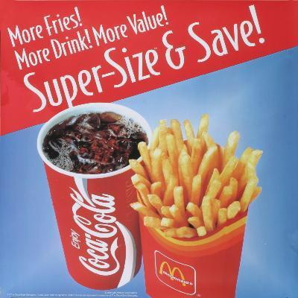
Up-selling
Getting customers to more expensive variants or add-ons to products

Slide 5
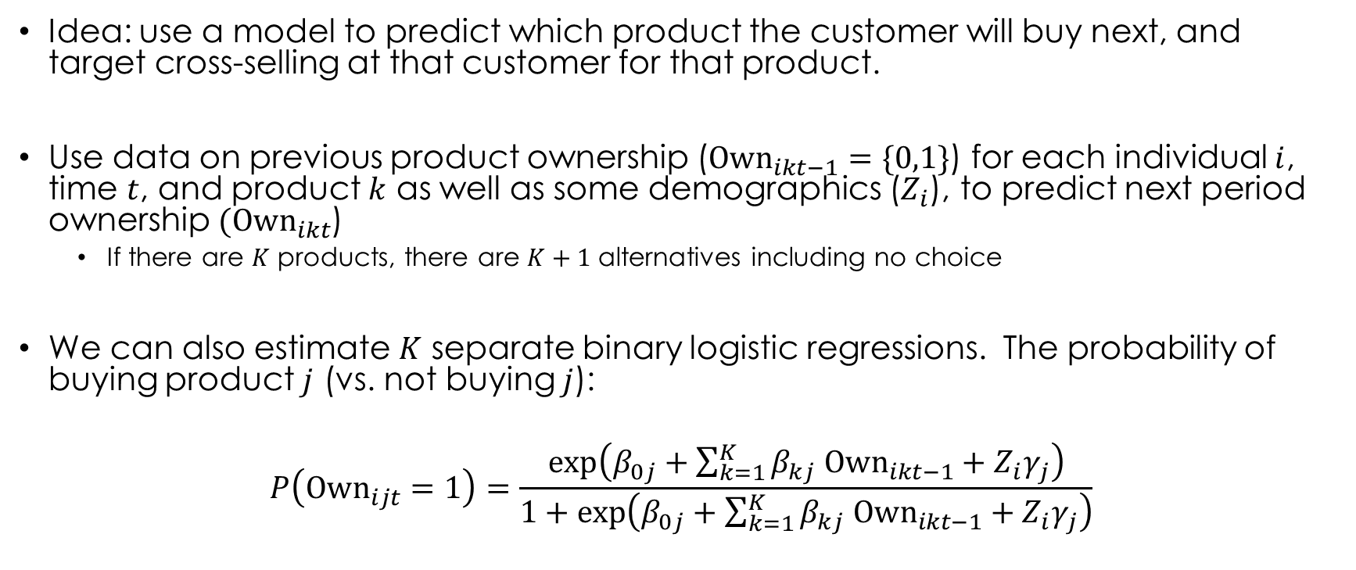
Next product to buy (NPTB)
Idea: use a model to predict which product the customer will buy next, and target cross-selling at that customer for that product.
Use data on previous product ownership (${\text{Own}}_{ikt−1}=\{0,1\}$) for each individual $i$, time $t$, and product $k$ as well as some demographics ($Z_{i}$), to predict next period ownership $({\text{Own}}_{ikt}$)
If there are $K$ products, there are $K+1$ alternatives including no choice
We can also estimate $K$ separate binary logistic regressions. The probability of buying product $j$ (vs. not buying $j$):
$$P\left({\text{Own}}_{ijt}=1\right)=\frac{\exp\left(β_{0j}+\sum_{k=1}^{K}{β_{kj} {\text{Own}}_{ikt−1}}+Z_{i}γ_{j}\right)}{1+\exp\left(β_{0j}+\sum_{k=1}^{K}{β_{kj} {\text{Own}}_{ikt−1}}+Z_{i}γ_{j}\right)}$$
Next-product-to-buy models for cross-selling applications
Notes:
The probability of owning j in period t is a function of all the different products the customer owned in the last period, including product j.

Slide 6



Odds ratios = $\exp\left(β_{kj}\right)$
$$Current period$$
$$Last period$$
For most products, owning it in t-1 strongly increases the probability that customers buy it again in t.
BKN p. 522
Notes:
However, if we predict the customer is going to buy this product next, why do we need to cross-sell it? The next-product-to-buy approach implicitly views this as a data problem. It would be ideal to survey Customer A and ask what product he or she needs. Since we do not have that data, we look at what products customers with similar profiles (current product ownership, personal characteristics) have bought next, and assume that is what Customer A needs (see Knott et al. 2002 for further discussion).
A/B Test of this model using holdout sample very profitable.

Slide 7
Many products
NPTB models break down when the number of products gets large

Slide 8

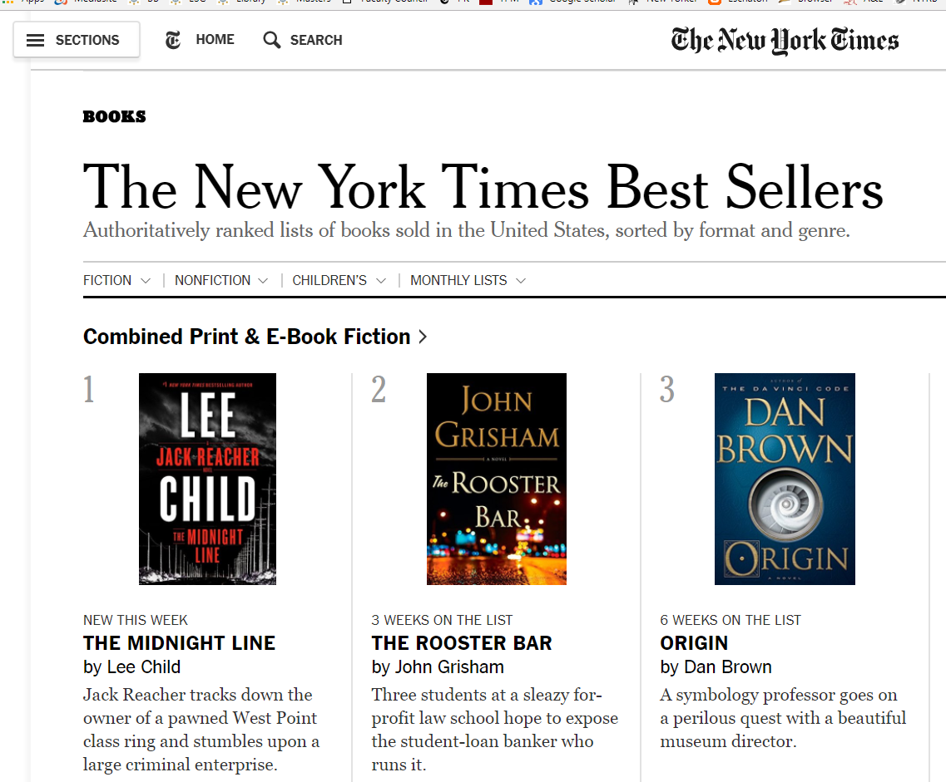
Traditional product discovery
What’s popular
Reviews
Notes:
Narrow coverage
Not customized

Slide 9
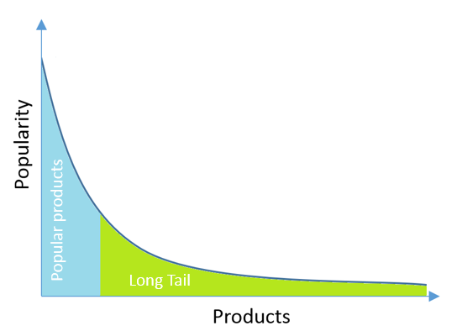
Traditional discovery leaves most products left out
Can automated product discovery – recommender systems – do better?
Notes:
Long tail unpopular and new products

Slide 10
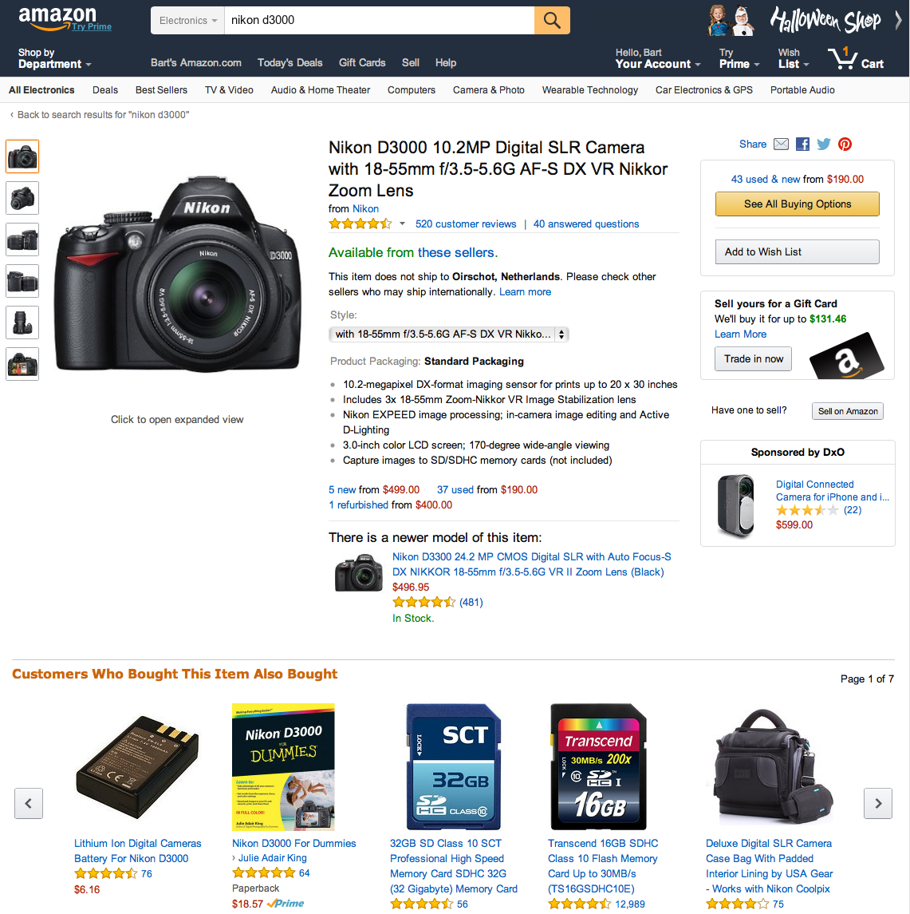
Recommender Systems
Inbound customization
Use big data on consumer views, purchases and reviews
Use methods to make customized dynamic recommendations
Notes:
Not just reviews.
Amazon says 35% come from RS; Netflix 80%

Slide 11
Key issues
What type of data do you use to build the RS?
How do you make predictions?
How do you measure success or performance of the RS?

Slide 12
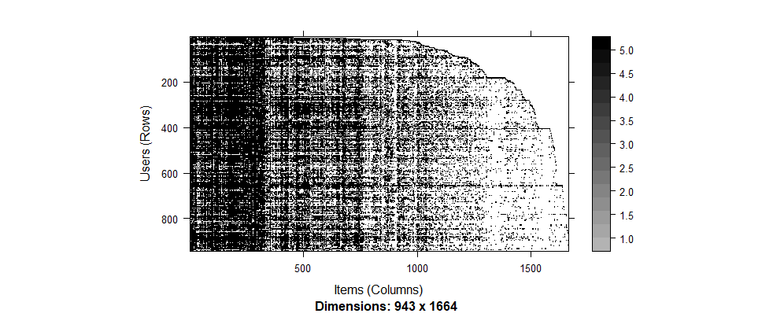
Most important data challenge: sparsity
The data was collected through the MovieLens web site (movielens.umn.edu) during Sept 1997 - Apr 1998. The data set contains ~100k ratings (1-5) from 943 users on 1664 movies. Each user has rated at least 19 movies.
6% of entries non-missing
Matrix is sparse: most users haven’t rated most movies
Notes:
In the Netflix data, 1% non-missing

Slide 13
1. Collecting data: ratings
 | Jungle Book | Civil War | Deadpool | Zootopia
Adam | 5 |  | 1
Ben |  | 4 |  | 3
Chris | 2 |  | 4
David |  |  |  | 2
???
???
???
???
???
???
???
???
???
“Cold start” problem
New items have no ratings/viewings
New users have no history

Slide 14
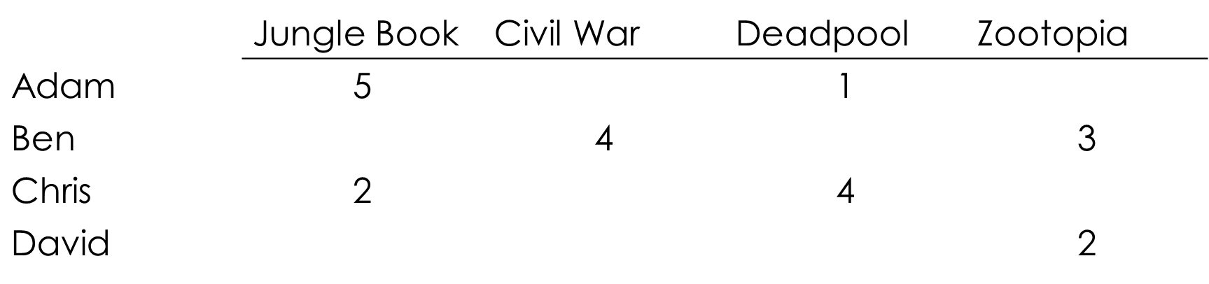
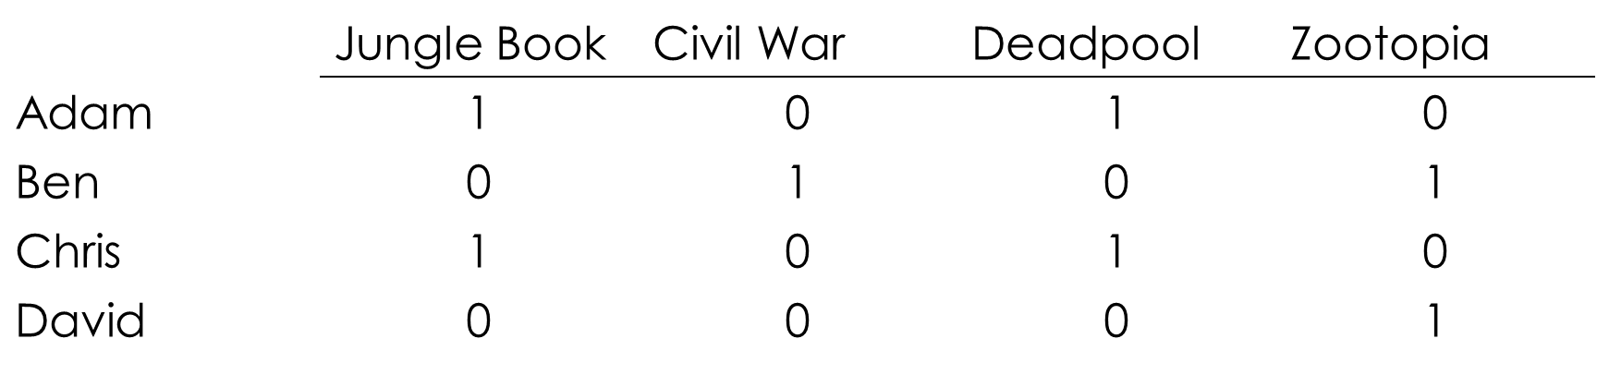
1. Collecting data
Explicit
Implicit
(base on actions like consuming or viewing)
Simple: ask people to rate items
Not scalable: most users don’t leave ratings
Scalable: learn ratings from user actions
Purchase implies high rating
Hard to learn low ratings
Does non-purchase mean not aware or aware but does not like?

Slide 15
Prediction: a few approaches
Content filtering: making recommendations based on item attributes and user preferences for attributes.
Recommend action movies to teenage males
Collaborative filtering: based on similarities between users and products.
Recommend X if liked Y, because others who liked Y liked X
3. Matrix factorization: use low dimensional factors to approximate sparse matrix

Slide 16
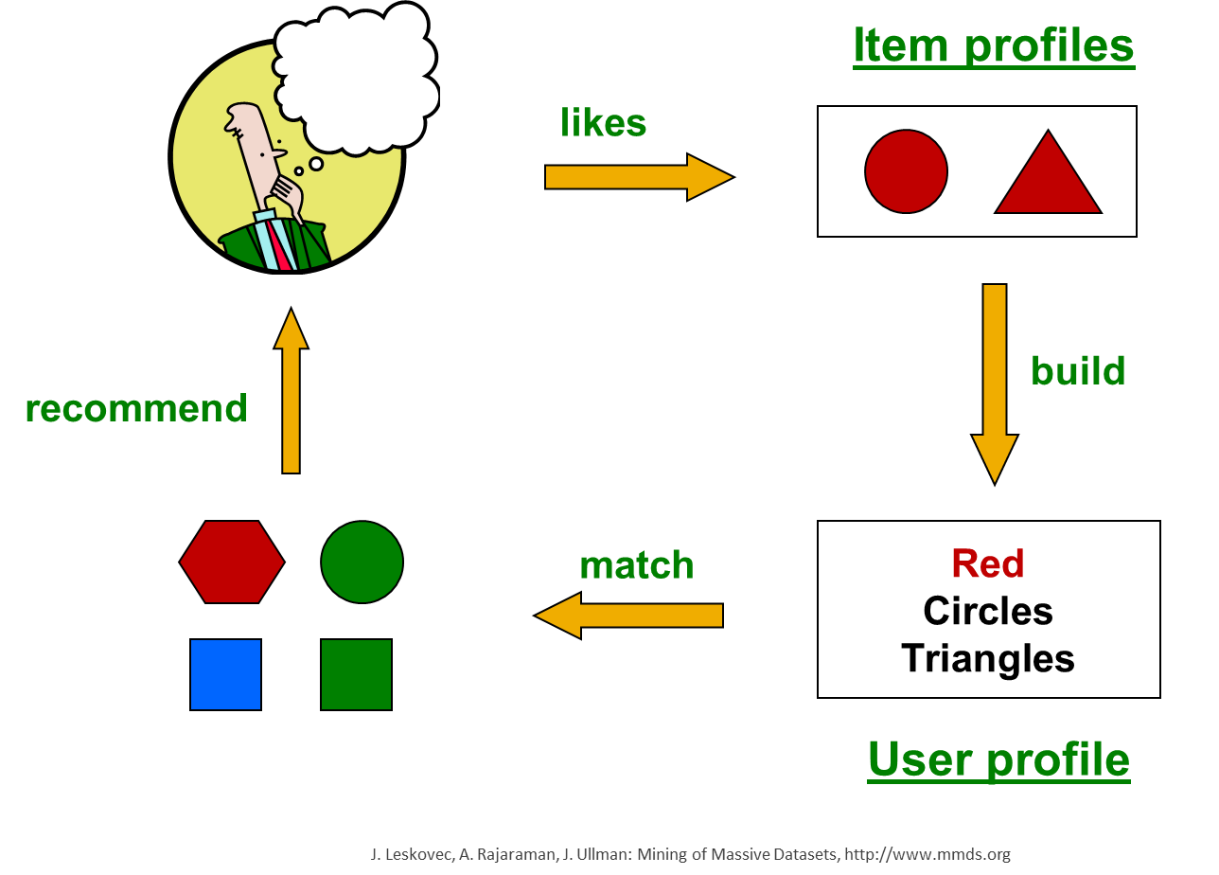
Content-based recommendations
Recommend items to customer similar to previous items rated highly by customer
Recommendation Systems

Slide 17
Building item profiles
Profile is a set of features
Movies: author, title, actor,
Images, videos: metadata, tags
People: set of friends
Can also use tags, scripts or summaries, e.g., “surprise”
Item profile #1
Item profile #2
 | Pretty Woman | Total Recall
AS | 0 | 1
JR | 1 | 0
“surprise” | 0.1 | 0.4

Slide 18


User Profiles
movies
 | Pretty Woman | Total Recall | Erin Brockovich | Terminator 2 | Predator
AS | 0 | 1 | 0 | 1 | 1
JR | 1 | 0 | 1 | 0 | 0
“surprise” | 0.1 | 0.4 | 0.1 | 0 | 0.1
attributes
$$V(i,j)$$
Adam’s ratings
3 | 1 | 5 | 2 | 4
$$r$$
Adam’s normalized ratings
0 | -2 | 2 | -1 | 1

Slide 19
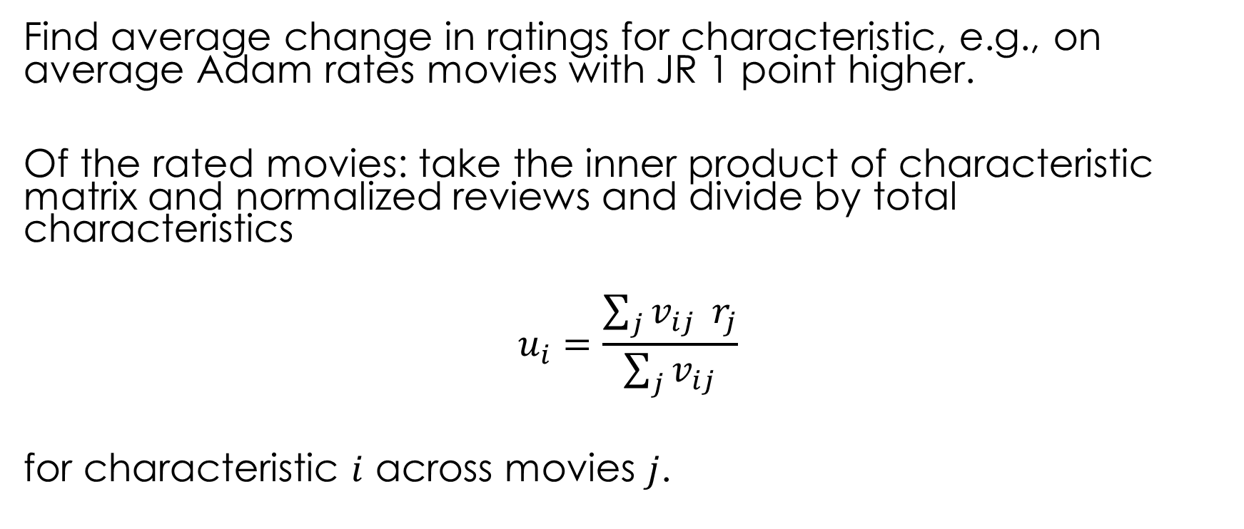
User profile
Find average change in ratings for characteristic, e.g., on average Adam rates movies with JR 1 point higher.
Of the rated movies: take the inner product of characteristic matrix and normalized reviews and divide by total characteristics
$$u_{i}=\frac{\sum_{j}{v_{ij}} r_{j}}{\sum_{j}{v_{ij}}}$$
for characteristic $i$ across movies $j$.
sum across movies
 | Adam
AS | -0.67
JR | 1
“surprise” | -0.71

Slide 20
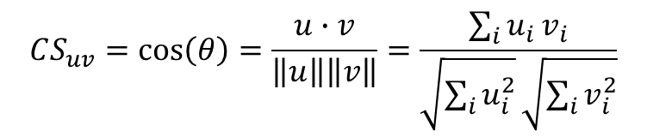





Vector space model
We now have an item profile and a user profile in terms of $I$ characteristics
The similarity between them is measured as the angle between the vectors
$$v$$
$$CS_{uv}=\cos\left(θ\right)=\frac{u∙v}{\left\|u\right\|\left\|v\right\|}=\frac{\sum_{i}{u_{i}}v_{i}}{\sqrt{\sum_{i}{u_{i}^{2}}}\sqrt{\sum_{i}{v_{i}^{2}}}}$$
$$u$$
$$θ$$
If $\cos\left(θ\right)=1$, angle $θ=0$

Slide 21
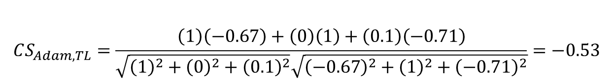
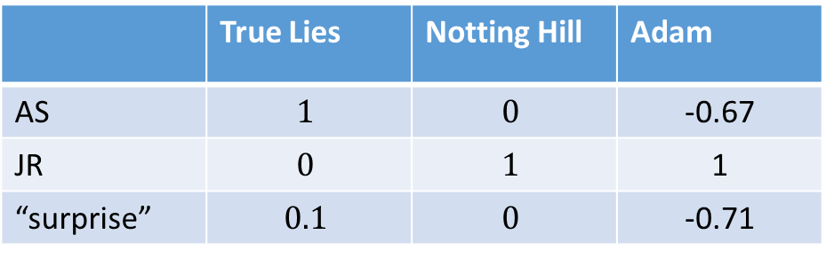
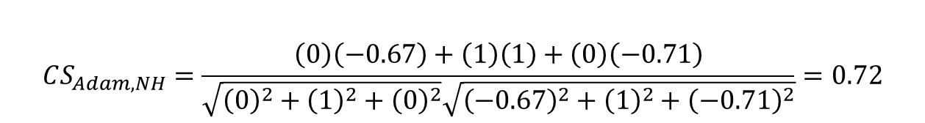
Example: Making predictions
 | True Lies | Notting Hill | Adam
AS | $$1$$ | $$0$$ | -0.67
JR | $$0$$ | $$1$$ | 1
“surprise” | $$0.1$$ | $$0$$ | -0.71
$$CS_{Adam, TL}=\frac{\left(1\right)\left(−0.67\right)+\left(0\right)\left(1\right)+\left(0.1\right)\left(−0.71\right)}{\sqrt{{\left(1\right)}^{2}+{\left(0\right)}^{2}+{\left(0.1\right)}^{2}}\sqrt{{\left(−0.67\right)}^{2}+{\left(1\right)}^{2}+{\left(−0.71\right)}^{2}}}=−0.53$$
$$CS_{Adam, NH}=\frac{\left(0\right)\left(−0.67\right)+\left(1\right)\left(1\right)+\left(0\right)\left(−0.71\right)}{\sqrt{{\left(0\right)}^{2}+{\left(1\right)}^{2}+{\left(0\right)}^{2}}\sqrt{{\left(−0.67\right)}^{2}+{\left(1\right)}^{2}+{\left(−0.71\right)}^{2}}}=0.72$$

Slide 22
Content-based approach
Positives
Negatives
No need for data on other users
Good for unique tastes
Able to recommend new & unpopular items
No cold-start for items problem
Can explain why something was recommended (JR +)
Finding features is hard
Hard to classify experience goods based on artists, genres, etc.
Overspecialization
Never recommends items outside content profile
Cold-start problem for users
How do you build a profile for a new user?

Slide 23
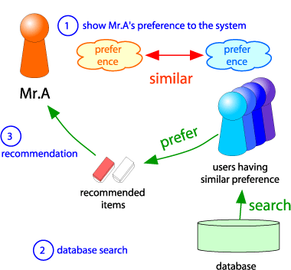
Collaborative Filtering
Consider Mr. A
Find other users whose ratings are similar to Mr. A’s
Estimate Mr. A’s ratings based on ratings of similar users.
(This is called “user-based” collaborative filtering; also item-based)

Slide 24
User-based collaborative filtering
We’re going to guess correlations
 | Pretty Woman | Total Recall | Erin Brockovich | Terminator 2 | Predator | Notting Hill
Adam | 2 | 5 | 4 | 2 | ? | ?
Ben | 5 | 1 | 2 |  | 1
Cindy | 5 | 5 | 5 | 5 | 5 | 5
Dave | 2 | 5 |  | 3
Emily | 5 | 3 | 5 | 3 |  | 5
Fred | 1 | 5 |  |  |  | 1
George | 2 |  | 5 |  | 5
Adam’s ratings are positively correlated to those of Fred and George
Notes:
Fred and George similar; Ben negative; Dave Cindy Emily not useful
Predator good
Notting hill bad

Slide 25
User-based collaborative filtering
 | Pretty Woman | Total Recall | Erin Brockovich | Terminator 2 | Predator | Notting Hill
Adam | 2 | 5 | 4 | 2 | ? | ?
Ben | 5 | 1 | 2 |  | 1
Cindy | 5 | 5 | 5 | 5 | 5 | 5
Dave | 2 | 5 |  | 3
Emily | 5 | 3 | 5 | 3 |  | 5
Fred | 1 | 5 |  |  |  | 1
George | 2 |  | 5 |  | 5
Adam’s ratings are negatively correlated to those of Ben

Slide 26
User-based collaborative filtering
 | Pretty Woman | Total Recall | Erin Brockovich | Terminator 2 | Predator | Notting Hill
Adam | 2 | 5 | 4 | 2 | ? | ?
Ben | 5 | 1 | 2 |  | 1
Cindy | 5 | 5 | 5 | 5 | 5 | 5
Dave | 2 | 5 |  | 3
Emily | 5 | 3 | 5 | 3 |  | 5
Fred | 1 | 5 |  |  |  | 1
George | 2 |  | 5 |  | 5
Adam’s rating for Predator is positively related to George and negatively to Ben.
Adam’s rating for Notting Hill is positively related to Fred.

Slide 27
Item-based collaborative filtering
 | Pretty Woman | Total Recall | Erin Brockovich | Terminator 2 | Predator | Notting Hill
Adam | 2 | 5 | 4 | 2 | ? | ?
Ben | 5 | 1 | 2 |  | 1
Cindy | 5 | 5 | 5 | 5 | 5 | 5
Dave | 2 | 5 |  | 3
Emily | 5 | 3 | 5 | 3 |  | 5
Fred | 1 | 5 |  |  |  | 1
George | 2 |  | 5 |  | 5
Predator’s ratings are positively correlated to those of Total Recall and Erin Brockovich

Slide 28
Item-based collaborative filtering
 | Pretty Woman | Total Recall | Erin Brockovich | Terminator 2 | Predator | Notting Hill
Adam | 2 | 5 | 4 | 2 | ? | ?
Ben | 5 | 1 | 2 |  | 1
Cindy | 5 | 5 | 5 | 5 | 5 | 5
Dave | 2 | 5 |  | 3
Emily | 5 | 3 | 5 | 3 |  | 5
Fred | 1 | 5 |  |  |  | 1
George | 2 |  | 5 |  | 5
Notting Hill’s ratings are positively correlated to those of Pretty Woman

Slide 29
Item vs. User based CF
In theory, item- and user-based CF are dual approaches
In practice item-based predicts better than user-based
Why? Items are “simpler” than users
Items belong to a small set of “genres”, users have varied tastes
Adam can like baroque organ music and acid rock
A song is unlikely to be to be categorized as both
Item similarity is more meaningful than user similarity

Slide 30
Collaborative Filtering
Positives
Negatives
Works for any kind of item
No feature selection needed
Cold start
Need enough users in the system to find a match
Cannot recommend unrated item
New items, esoteric items
Sparsity
User matrix is sparse
Hard to find users that have rated the same set of items
Popularity bias
Tends to recommend popular items
“Harry Potter effect”

Slide 31
Matrix factorization
X
U
V
“genres”
≈
“preferences”
1000 x 1600 matrix
1000 x d matrix
d x 1600 matrix
= 1600000
= 5000 + 8000 if d = 5

Slide 32
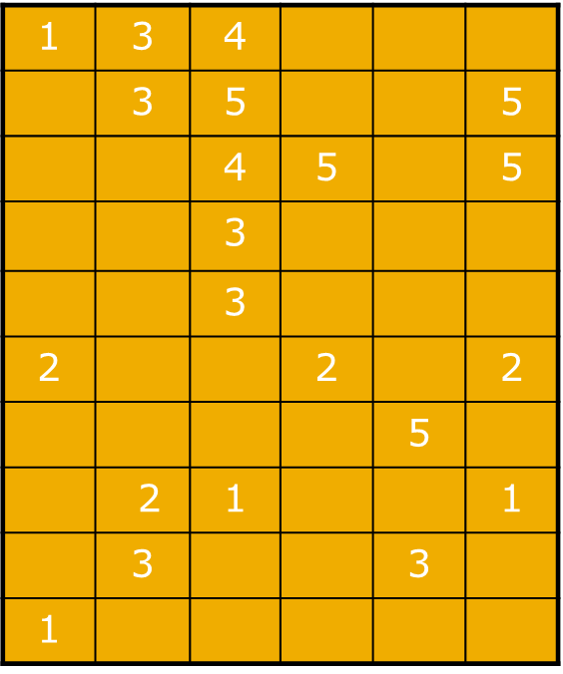
3. How do you evaluate RS?
movies
How well does model predict out-of-sample, in the “test” or validation set.
Calibration/training: fit model (80% of users)
Validation/training: make predictions and test (20%)
Known/given: used to make predictions on other part
Unknown: used to evaluate predictions
calibration
“training” set
users
2 | 3 | 2
 | 2 | 1
1 | 4 | 3
 | 2 | 3
 | 1 | 2
? |  | ?
 | ?
 |  | ?
 | ?
validation
“test” set
validation
unknown ratings = test predictions
validation
“given” set = known ratings

Slide 33
Challenges with recommender systems
Why recommend a product the customer was going to buy anyhow?
Consider the counterfactual: what would have happened had the user not seen the recommendation?
Not enough diversity in recommendations
If I like one Harry Potter movie, my recommendations is all Harry Potter movies
I no longer need the product recommended after I buy in the category (preferences change; see Amazon recommendations)

Slide 34
Wrapping up
Using analytics to customize: which product to which customer? (when and over what channel)
Cross-selling, up-selling and recommender systems
Important drivers: product ownership, similarity to others, attributes of products

